Slide 1
Optimization Algorithms

Slide 2
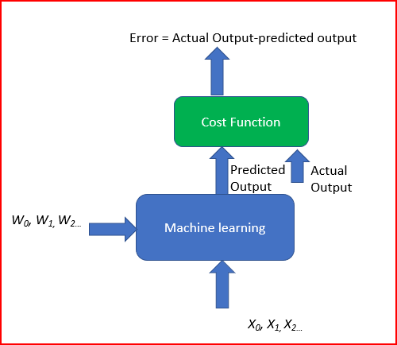
The objective of Machine Learning algorithm
The goal of machine learning and deep learning is to reduce the difference between the predicted output and the actual output. This is also called as a Cost function(C) or Loss function. Cost functions are convex functions.
As our goal is to minimize the cost function by finding the optimized value for weights. We also need to ensure that the algorithm generalizes well. This will help make a better prediction for the data that was not seen before
To achieve this we run multiple iterations with different weights. This helps to find the minimum cost. This is Gradient descent.

Slide 3
Optimization Algorithms For Training Neural Network
Optimizers are algorithms or methods used to change the attributes of your neural network such as weights and learning rate in order to reduce the losses.

Slide 4
Gradient descent
Gradient descent is one of the most popular algorithms to perform optimization and by far the most common way to optimize neural networks. At the same time, every state-of-the-art Deep Learning library contains implementations of various algorithms to optimize gradient descent.
Gradient descent is an iterative machine learning optimization algorithm to reduce the cost function. This will help models to make accurate predictions.
Gradient indicates the direction of increase. As we want to find the minimum point in the valley we need to go in the opposite direction of the gradient. We update parameters in the negative gradient direction to minimize the loss.

Slide 5
Gradient descent
Gradient descent is a way to minimize an objective function J(θ) parameterized by a model's parameters θ∈Rd by updating the parameters in the opposite direction of the gradient of the objective function ∇θJ(θ) w.r.t. to the parameters.
The learning rate η determines the size of the steps we take to reach a (local) minimum.
In other words, we follow the direction of the slope of the surface created by the objective function downhill until we reach a valley

Slide 6
Gradient Descent
Advantages:
Easy computation.
Easy to implement.
Easy to understand.
Disadvantages:
May trap at local minima.
Weights are changed after calculating gradient on the whole dataset. So, if the dataset
is too large than this may take years to converge to the minima.
Requires large memory to calculate gradient on the whole dataset.

Slide 7
Gradient descent variants
There are three variants of gradient descent, which differ in how much data we use to compute the gradient of the objective function. Depending on the amount of data, we make a trade-off between the accuracy of the parameter update and the time it takes to perform an update.
Gradient descent is a first-order optimization algorithm which is dependent on the first order derivative of a loss function. It calculates that which way the weights should be altered so that the function can reach a minima. Through backpropagation, the loss is transferred from one layer to another and the model’s parameters also known as weights are modified depending on the losses so that the loss can be minimized.

Slide 8
Types of Gradient Descent
Batch Gradient Descent or Vanilla Gradient Descent
Stochastic Gradient Descent
Mini batch Gradient Descent

Slide 9
Batch gradient descent
Batch gradient descent, computes the gradient of the cost function w.r.t. to the parameters θ for the entire training dataset:
θ=θ−η⋅∇θJ(θ).
As we need to calculate the gradients for the whole dataset to perform just one update, batch gradient descent can be very slow and is intractable for datasets that don't fit in memory.
Batch gradient descent also doesn't allow us to update our model online, i.e. with new examples on-the-fly.

Slide 10
for i in range(nb_epochs):
params_grad = evaluate_gradient(loss_function, data, params)
params = params - learning_rate * params_grad
For a pre-defined number of epochs, we first compute the gradient vector params_grad of the loss function for the whole dataset w.r.t. our parameter vector params. Note that state-of-the-art deep learning libraries provide automatic differentiation that efficiently computes the gradient w.r.t. some parameters.
We then update our parameters in the opposite direction of the gradients with the learning rate determining how big of an update we perform. Batch gradient descent is guaranteed to converge to the global minimum for convex error surfaces and to a local minimum for non-convex surfaces.

Slide 11
Stochastic gradient descent
Stochastic gradient descent (SGD) in contrast performs a parameter update for each training example x^{(i)} and label y^{(i)}:
θ=θ−η⋅∇_{θ}J(θ;x^{(i)};y^{(i)}).
Batch gradient descent performs redundant computations for large datasets, as it recomputes gradients for similar examples before each parameter update.
SGD does away with this redundancy by performing one update at a time. It is therefore usually much faster and can also be used to learn online.

Slide 12
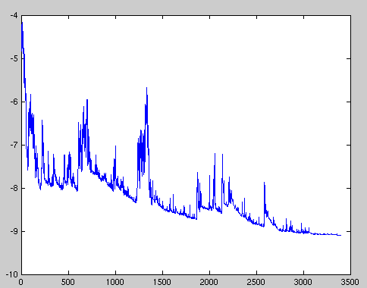
Stochastic gradient descent
SGD performs frequent updates with a high variance that cause the objective function to fluctuate heavily as in Image 1.
While batch gradient descent converges to the minimum of the basin the parameters are placed in, SGD's fluctuation, on the one hand, enables it to jump to new and potentially better local minima. On the other hand, this ultimately complicates convergence to the exact minimum, as SGD will keep overshooting. However, it has been shown that when we slowly decrease the learning rate, SGD shows the same convergence behaviour as batch gradient descent, almost certainly converging to a local or the global minimum for non-convex and convex optimization respectively.

Slide 13
Stochastic gradient descent
for i in range(nb_epochs):
np.random.shuffle(data)
for example in data:
params_grad = evaluate_gradient(loss_function, example,params)
params = params - learning_rate * params_grad
Its code fragment simply adds a loop over the training examples and evaluates the gradient w.r.t. each example. Note that we shuffle the training data at every epoch

Slide 14
Stochastic Gradient Descent
Advantages:
Frequent updates of model parameters, hence, converges in less time.
Requires less memory as no need to store values of loss functions.
May get new minima.
Disadvantages:
High variance in model parameters.
May shoot even after achieving global minima.
To get the same convergence as gradient descent needs to slowly reduce the value of
learning rate.

Slide 15
Mini-batch gradient descent
Mini-batch gradient descent finally takes the best of both worlds and performs an update for every mini-batch of n training examples:
θ=θ−η⋅∇_{θ}J(θ;x^{(i:i+n)};y^{(i:i+n)}).
reduces the variance of the parameter updates, which can lead to more stable convergence; and
b) can make use of highly optimized matrix optimizations common to state-of-the-art deep learning libraries that make computing the gradient w.r.t. a mini-batch very efficient.
Common mini-batch sizes range between 50 and 256, but can vary for different applications.

Slide 16
Mini-batch gradient descent
In code, instead of iterating over examples, we now iterate over mini-batches of size 50:
for i in range(nb_epochs):
np.random.shuffle(data)
for batch in get_batches(data, batch_size=50):
params_grad = evaluate_gradient(loss_function, batch, params)
params = params - learning_rate * params_grad

Slide 17
Challenges
Choosing a proper learning rate can be difficult. A learning rate that is too small leads to painfully slow convergence, while a learning rate that is too large can hinder convergence and cause the loss function to fluctuate around the minimum or even to diverge.
Another key challenge of minimizing highly non-convex error functions common for neural networks is avoiding getting trapped in their numerous suboptimal local minima. These saddle points are usually surrounded by a plateau of the same error, which makes it notoriously hard for SGD to escape, as the gradient is close to zero in all dimensions.

Slide 18
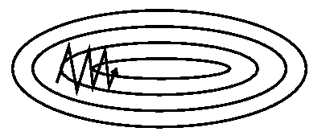
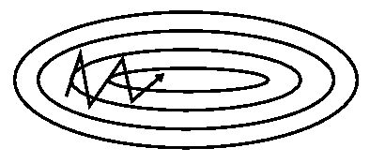
Momentum
In these scenarios, SGD oscillates across the slopes of the ravine while only making hesitant progress along the bottom towards the local optimum as in Image 1.
Momentum is a method that helps accelerate SGD in the relevant direction and dampens oscillations as can be seen in Image 2. It does this by adding a fraction γ of the update vector of the past time step to the current update vector:
vt=γvt−1+η∇θJ(θ)
θ=θ−vt

Slide 19
The momentum term γ is usually set to 0.9 or a similar value.
Essentially, when using momentum, we push a ball down a hill. The ball accumulates momentum as it rolls downhill, becoming faster and faster on the way (until it reaches its terminal velocity if there is air resistance, i.e. γ<1
). The same thing happens to our parameter updates: The momentum term increases for dimensions whose gradients point in the same directions and reduces updates for dimensions whose gradients change directions. As a result, we gain faster convergence and reduced oscillation.

Slide 20
Adagrad
Adagrad is an algorithm for gradient-based optimization that does just this: It adapts the learning rate to the parameters, performing smaller updates (i.e. low learning rates) for parameters associated with frequently occurring features, and larger updates (i.e. high learning rates) for parameters associated with infrequent features. For this reason, it is well-suited for dealing with sparse data.
Previously, we performed an update for all parameters θ at once as every parameter θi used the same learning rate η. As Adagrad uses a different learning rate for every parameter θi at every time step t, we first show Adagrad's per-parameter update, which we then vectorize.

Slide 21
Previously, we performed an update for all parameters θ at once as every parameter θi used the same learning rate η.
As Adagrad uses a different learning rate for every parameter θi at every time step t, we first show Adagrad's per-parameter update, which we then vectorize.
Here use gt to denote the gradient at time step t. gt,i is then the partial derivative of the objective function w.r.t. to the parameter θi at time step t:
gt,i=∇θJ(θt,i).
The SGD update for every parameter θi at each time step t then becomes: t+1,i=θt,i−η⋅gt,i.

Slide 22
In its update rule, Adagrad modifies the general learning rate η at each time step t for every parameter θi based on the past gradients that have been computed for θi:
One of Adagrad's main benefits is that it eliminates the need to manually tune the learning rate. Most implementations use a default value of 0.01 and leave it at that.

Slide 23
Adagrad's main weakness is its accumulation of the squared gradients in the denominator:.
Since every added term is positive, the accumulated sum keeps growing during training.
This in turn causes the learning rate to shrink and eventually become infinitesimally small, at which point the algorithm is no longer able to acquire additional knowledge. The Adadelta algorithms aim to resolve this flaw.
It is well suited when we have sparse data as in large scale neural networks.
Adagrad eliminates the need to manually tune the learning rate.

Slide 24
Adadelta
Adadelta is an extension of Adagrad that seeks to reduce its aggressive, monotonically decreasing learning rate. Instead of accumulating all past squared gradients, Adadelta restricts the window of accumulated past gradients to some fixed size w.
Instead of inefficiently storing w previous squared gradients, the sum of gradients is recursively defined as a decaying average of all past squared gradients. The running average E[g2]t at time step t then depends (as a fraction γ similarly to the Momentum term) only on the previous average and the current gradient:

Slide 25
We set γ to a similar value as the momentum term, around 0.9. For clarity, we now rewrite our vanilla SGD update in terms of the parameter update vector Δθt:
The parameter update vector of Adagrad that we derived previously thus takes the form:

Slide 26
We now simply replace the diagonal matrix Gt with the decaying average over past squared gradients E[g2]t:

Slide 27
RMSProp
RMSProp is Root Mean Square Propagation. It was devised by Geoffrey Hinton.
RMSProp tries to resolve Adagrad’s radically diminishing learning rates by using a moving average of the squared gradient. It utilizes the magnitude of the recent gradient descents to normalize the gradient.
In RMSProp learning rate gets adjusted automatically and it chooses a different learning rate for each parameter.
RMSProp divides the learning rate by the average of the exponential decay of squared gradients

Slide 28
RMSprop
RMSprop is an unpublished, adaptive learning rate method proposed by Geoff Hinton.
RMSprop and Adadelta have both been developed independently around the same time stemming from the need to resolve Adagrad's radically diminishing learning rates. RMSprop in fact is identical to the first update vector of Adadelta that we derived above:
RMSprop as well divides the learning rate by an exponentially decaying average of squared gradients. Hinton suggests γ to be set to 0.9, while a good default value for the learning rate η is 0.001.

Slide 29
Adam — Adaptive Moment Estimation
Another method that calculates the individual adaptive learning rate for each parameter from estimates of first and second moments of the gradients.
It also reduces the radically diminishing learning rates of Adagrad
Adam can be viewed as a combination of Adagrad, which works well on sparse gradients and RMSprop which works well in online and nonstationary settings.
Adam implements the exponential moving average of the gradients to scale the learning rate instead of a simple average as in Adagrad. It keeps an exponentially decaying average of past gradients
Adam is computationally efficient and has very little memory requirement
Adam optimizer is one of the most popular gradient descent optimization algorithms

Slide 30
Adam
Adaptive Moment Estimation (Adam) is another method that computes adaptive learning rates for each parameter.
In addition to storing an exponentially decaying average of past squared gradients vt like Adadelta and RMSprop, Adam also keeps an exponentially decaying average of past gradients mt, similar to momentum. Whereas momentum can be seen as a ball running down a slope, Adam behaves like a heavy ball with friction, which thus prefers flat minima in the error surface .We compute the decaying averages of past and past squared gradients mt and vt respectively as follows:

Slide 31
mt and vt are estimates of the first moment (the mean) and the second moment (the uncentered variance) of the gradients respectively, hence the name of the method. As mt and vt are initialized as vectors of 0's, the authors of Adam observe that they are biased towards zero, especially during the initial time steps, and especially when the decay rates are small (i.e. β1 and β2 are close to 1).

Slide 32
They then use these to update the parameters just as we have seen in Adadelta and RMSprop, which yields the Adam update rule:
The authors propose default values of 0.9 for β1, 0.999 for β2, and 10−8 for ϵ. They show empirically that Adam works well in practice and compares favorably to other adaptive learning-method algorithms.

Slide 33
Further Reading
AdaMax
Nadam
AMSGrad
AdamW , which fixes weight decay in Adam; QHAdam , which averages a standard SGD step with a momentum SGD step; and AggMo , which combines multiple momentum terms γ; and others.
An updated overview of recent gradient descent algorithms
https://johnchenresearch.github.io/demon/

Slide 34
Which optimizer to use?
If your input data is sparse, then you likely achieve the best results using one of the adaptive learning-rate methods.
RMSprop is an extension of Adagrad that deals with its radically diminishing learning rates. It is identical to Adadelta, except that Adadelta uses the RMS of parameter updates in the numinator update rule.
Adam, finally, adds bias-correction and momentum to RMSprop. Insofar, RMSprop, Adadelta, and Adam are very similar algorithms that do well in similar circumstances, Adam might be the best overall choice.
Many recent papers use vanilla SGD without momentum and a simple learning rate annealing schedule.
Consequently, if you care about fast convergence and train a deep or complex neural network, you should choose one of the adaptive learning rate methods.

Slide 35
Batch normalization
To facilitate learning, we typically normalize the initial values of our parameters by initializing them with zero mean and unit variance. As training progresses and we update parameters to different extents, we lose this normalization, which slows down training and amplifies changes as the network becomes deeper.
Batch normalization ^{[30]} reestablishes these normalizations for every mini-batch and changes are back-propagated through the operation as well. By making normalization part of the model architecture, we are able to use higher learning rates and pay less attention to the initialization parameters. Batch normalization additionally acts as a regularizer, reducing (and sometimes even eliminating) the need for Dropout.

Slide 36
Early stopping
According to Geoff Hinton: "Early stopping (is) beautiful free lunch" (NIPS 2015 Tutorial slides, slide 63). You should thus always monitor error on a validation set during training and stop (with some patience) if your validation error does not improve enough

Slide 39
Important
https://ruder.io/optimizing-gradient-descent/index.html#gradientdescentvariants
https://www.youtube.com/playlist?list=PLbRMhDVUMngc7NM-gDwcBzIYZNFSK2N1a
https://krishnaik.in/2022/03/28/understanding-all-optimizers-in-deep-learning/

Slide 40
https://medium.datadriveninvestor.com/overview-of-different-optim
izers-for-neural-networks-e0ed119440c3
https://www.youtube.com/playlist?list=PLbRMhDVUMngc7NM-gDwcBzIYZNFSK2N1a
https://artemoppermann.com/optimization-in-deep-learning-adagrad-rmsprop-adam/
https://ruder.io/optimizing-gradient-descent/index.html#shufflingandcurriculumlearning
https://ruder.io/optimizing-gradient-descent/index.html#gradientdescentvariants

Slide 41
https://towardsdatascience.com/learning-parameters-part-5-65a2f3583f7d
https://krishnaik.in/2022/03/28/understanding-all-optimizers-in-deep-learning/
https://medium.com/mlearning-ai/optimizers-in-deep-learning-7bf81fed78a0
https://towardsdatascience.com/optimizers-for-training-neural-network-59450d71caf6
https://towardsdatascience.com/optimizers-for-training-neural-network-59450d71caf6
https://www.analyticsvidhya.com/blog/2021/10/a-comprehensive-guide-on-deep-learning-optimizers/

Slide 43
https://ruder.io/optimizing-gradientdescent/index.html#gradientdescentvariants

